Slide 1
IABD – Unit 2
Typical areas of application of Analytics – Text analytics, Image Analytics, Graph Analytics, Business Analytics and Visualization &Visual Data analytics. Methodologies in Analytics in Big Data- Gartner’s Magic Quadrant, Descriptive Analytics, Diagnostic Analytics, Predictive Analytics, Prescriptive Analytics, Inquisitive Analytics and Birt Analytics, Explanation of each with examples
RS-MSRIT

Slide 2
IABD - UNIT 2 – Part 1
Domain-specific Analytics
Typical areas of application of Analytics – Text analytics, Image Analytics, Graph Analytics, Business Analytics and Visualization &Visual Data analytics. Methodologies in Analytics in Big Data- Gartner’s Magic Quadrant,
RS-MSRIT

Slide 3
Graph Analytics
Definition1: (by IBM)-http://www.ibmbigdatahub.com/blog/what-graph-analytics
Graph analytics, also known as network analysis, is an exciting new area
for analytics workloads.
Use Cases:
1. Detecting financial crimes such as money laundering
2. Spotting fraud:
- fraudulent transactions and applications in banking,
- applications and claims fraud in insurance
- fraudulent activities in telecommunications
3. Preventing crime and performing counterterrorism
4. Applying influencer analysis in social network communities
5. Identifying weaknesses in power grids
- water grids
- transportation networks
- helping prevent cybercrime attacks on computer networks
6. Optimizing routes in the airlines
- retail and manufacturing industries
- for supply distribution chains and logistics
7. Conducting research in life sciences (bioinformatics)
- medical research, disease pathologies,….
RS-MSRIT

Slide 4
Graph Analytics (contd.)
Types of Graph Analysis:
Path analysis: Used to determine the shortest distance between two nodes in a graph, for example.
- use case is route optimization applicable to logistics, supply and distribution
chains and traffic optimization for smart cities
2. Connectivity analysis: Applied tor determining weaknesses in networks such
as a utility power grid.
- also enables comparing connectivity across networks.
3.Community analysis: Distance and density–based analysis
- used to find groups of interacting people in a social network
- example: identifying whether they are transient and predicting if the network will grow
4. Centrality analysis: Enables identifying relevancy to find the most influential people in a social network
- example: to find most highly accessed web pages — such as by using the
PageRank algorithm.
* Graph algorithms include PageRank, Betweenness Centrality, Eigen Centrality
and Closeness.
RS-MSRIT

Slide 5
Graph Analytics (contd.)
In graph theory and network analysis, indicators of centrality identify the most
important vertices within a graph.
Applications include identifying the most influential person(s) in a social
network, key infrastructure nodes in the Internet or urban networks, and super-
spreaders of disease.
Degree centrality, is defined as the number of links incident upon a node (i.e.,
the number of ties that a node has
Closeness centrality (or closeness) of a node is the average length of
the shortest path between the node and all other nodes in the graph.
Betweenness centrality : quantifies the number of times a node acts as a
bridge along the shortest path between two other nodes.
Eigenvector centrality (also called eigencentrality) is a measure of the
influence of a node in a network
https://en.wikipedia.org/wiki/Centrality
RS-MSRIT

Slide 6
Graph Analytics (contd.)
Definition 2: https://developer.nvidia.com/discover/graphanalytics
* Graph Algorithms or Graph Analytics are analytic tools used to determine strength and direction of relationships between objects in a graph.
The focus of graph analytics is on pairwise relationship between two objects at a
time and structural characteristics of the graph as a whole.
* Graph analytics can help answer questions like the following:
1. How many other individuals does the average individual “friend” with?
2. What is the maximum number of “friends” any one individual has?
3. How interconnected are groups of users with one another?
4. How many “friend” relationships does it take to get from one user to another
user?
5. Are there isolated groups of individuals who are connected to each other but not
to individuals not in their group?
RS-MSRIT

Slide 7
Graph Analytics (contd.)
* Advantages Offered by Graph Analytics
1. ease with which new sources of data and new relationships can be added. - --
2. Graph databases using Resource Description Framework(RDF) to represent
the graph can easily merge and unify diverse datasets without significant
upfront investment in data modeling.
3. Such an approach lies in stark contrast to traditional analytics, in which a
great deal of time is spent organizing data, and the addition of new data sources
requires time-consuming and error prone effort by analysts.
4.The easy on-boarding of new data is particularly important when dealing with
Big Data.
* Traditional analytics focus on finding answers to known questions.
- By contrast, many of the highest value applications are focused on discovery,
where the questions to be answered are not known in advance.
5. The ability to quickly and easily add new data sources or new relationships
within the data when needed to support a new line of questioning is crucial for
discovery -graphs are uniquely well qualified to support these requirements.
6. Graph analytics also offer sophisticated capabilities for analyzing relationships,
- while traditional analytics focus on summarizing, aggregating and reporting
on data.
https://infocus.emc.com/william_schmarzo/how-can-graph-analytics-uncover-valuable-insights-about-data/
RS-MSRIT

Slide 8
Graph Analytics (contd.)
* Graph Analytics Complementary to Hadoop:
* Hadoop and graph analytics complement each other.
Hadoop is a scale-out solution, allowing independent items of work to be parceled
out to the computers in a cluster.
Graph analytics excel at looking at the “big picture,” analyzing complex networks of
relationships that cannot be partitioned.
For example, consider risk analysis within a financial solution.
- Many documents will need to be independently analyzed, and the relationships
between organizations extracted. This is an ideal job for Hadoop since each
document is independent of the others.
- On the other hand, the complex network of relationships between organizations
form a non-partitionable graph, which is best analyzed as a single entity, in memory.
https://infocus.emc.com/william_schmarzo/how-can-graph-analytics-uncover-valuable-insights-about-data/
RS-MSRIT

Slide 9
Graph Analytics (contd.)
Big data graph analytics is fundamentally different than big
data science
Different algorithms Different challenges Different hardware
requirements
Conventional database systems based tables and join
operations are insufficient
Data parallel graph crawls can be orders of magnitude faster
Needs new query languages capable of expressing graph
analytics operations and compiling to data parallel operations
RS-MSRIT

Slide 10
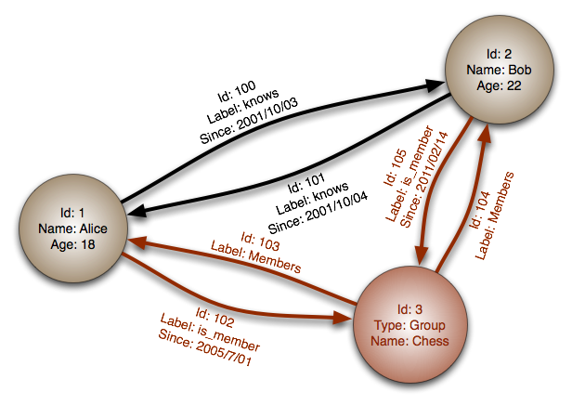
RS-MSRIT

Slide 11
Text Analytics
Text Analytics is the process of converting unstructured Text Data into meaningful meaning data for analysis:
- to measure customer opinions, product reviews, feedback
- to provide search facility, sentimental analysis and entity modeling to support
fact-based decision making
Makes sue of linguistic, statistical and machine learning techniques
Involves information retrieval from unstructured data and the process of
structuring the input text to derive patterns and trends, evaluating and
interpreting the output data
Also involves lexical analysis, categorization, clustering, pattern recognition,
tagging, annotation, information extraction, link and association analysis,
visualization and predictive analytics
http://www.predictiveanalyticstoday.com/text-analytics/
RS-MSRIT

Slide 12
Text Analytics (contd.)
Processes and Features of Text Analytics Solutions:
Text Mining, Text parsing, Text Identification, Text Extraction, Text
Categorization, Text Clustering
2. Extraction of Concepts, entities, relations and events
3. Creation of Taxonomies
4. Search Access, Web Crawling, indexing, duplicate document identification
5. Analyze all major file formats, all major languages- Natural Language
6. Entity relation model
7. Link analysis, link text repositories
8. Ability to identify and analyze sentiments
9. Document summarization features and records
10. Interactive visualization
http://www.predictiveanalyticstoday.com/text-analytics/
RS-MSRIT

Slide 13
Text Analytics (contd.)
Applications of Text Analytics
Sentiment Analysis
Search Access unstructured data
Email spam filters
Automated Ad placements
Social media monitoring
Competitive Intelligence
Enterprise business intelligence and data mining
E-discovery and Record management
National Security Intellignece
Scientific discovery (life sciences)
http://www.predictiveanalyticstoday.com/text-analytics/
RS-MSRIT

Slide 14
Text Analytics (contd.)
5 tools and techniques for text analytics:
Sentiment analysis:
* Analying the opinion or tone of what people are saying about your company on social media or through your call centre can help you respond to issues faster, see how your product and service is performing in the market, find out what customers are saying about competitors, and so on.
* Three ways of going about this kind of sentiment analysis,
a. Polarity analysis - simply identify if the tone of communications is positive or
negative.
b. Categorization - tools get more fine-grained and identify if someone’s
confused or angry,
c. Putting a scale on emotion from ‘sad’ to ‘happy’ and from 0-10.
http://www.cio.com.au/article/575209/5-tools-techniques-text-analytics/
RS-MSRIT

Slide 15
Text Analytics (contd.)
2. Topic Modeling:
Topic modeling is a useful technique for identifying dominant themes in a vast
array of documents and for dealing with a large corpus of text.
There are a couple of ways to go about topic modeling
a. Latent Dirichlet allocation, where words are automatically clustered into topics,
with a mixture of topics in each document.
b. probabilistic latent semantic indexing
- models co-occurrence data using probability.
Topic modeling gives a weight on the importance on each topic in each article
3. Term frequency – inverse document frequency (TF-IDF)
TF–IDF looks at how frequently a word appears in a document and its importance
relative to the whole set of documents.
4. Named Entity Recognition (NER)
NER looks at recognizing nouns and could be used to extract persons,
organisations, geographic locations, dates, monetary amounts, or the like from
text. This works by looking at the words surrounding them
5. Event extraction
Event extraction is a step further than NER but harder to do. It not only looks at nouns, or what is being talked about, but also what the relationship is between them and the kinds of inferences that can be made from incidents referred to in the text.
RS-MSRIT

Slide 16
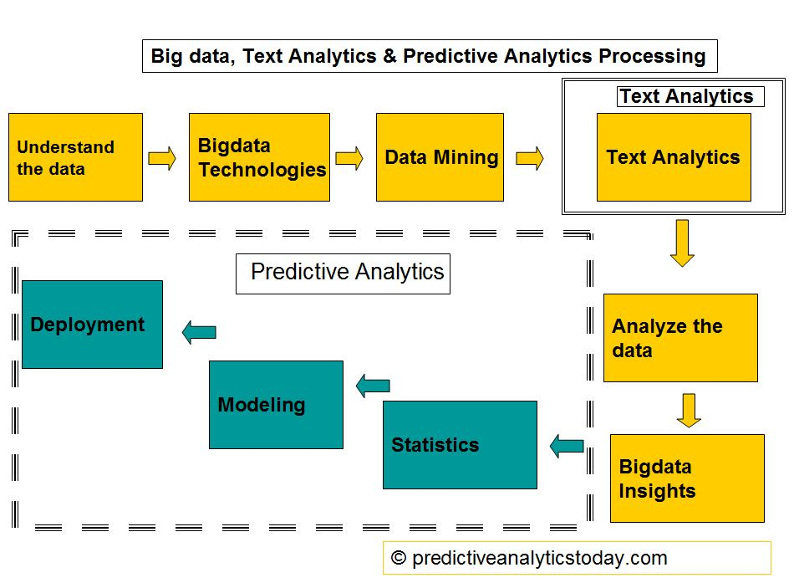
http://www.predictiveanalyticstoday.com/text-analytics/
RS-MSRIT

Slide 17
Text Mining
* Text Mining also known as Intelligent Text Analysis, Text Data Mining or Knowledge Discovery in Text (KDT) is the process of extracting interesting and non-trivial information and knowledge from unstructured text
(http://www.slideshare.net/dataminingcontent/textmining-introduction-2874468)
RS-MSRIT

Slide 18
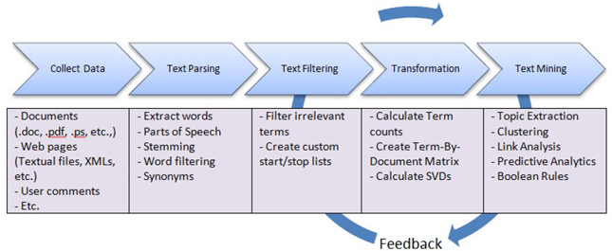
Text Mining Process Pipeline
Process is essentially a linear pipeline.
Feedback from the results of Text Mining might affect earlier preprocessing (to Parsing, or even data collection)..
condor.depaul.edu/ntomuro/courses/594/coursenotes/TM-1-Intro.ppt
RS-MSRIT

Slide 19
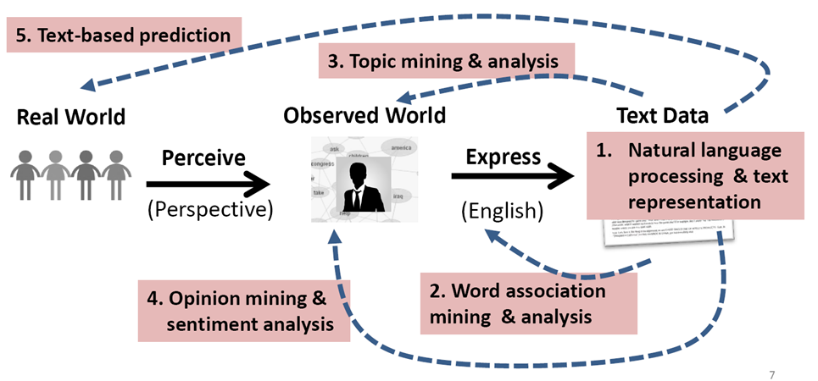
Text Mining Paradigm
condor.depaul.edu/ntomuro/courses/594/coursenotes/TM-1-Intro.ppt
RS-MSRIT

Slide 20
Image Analytics
Jean Martin offers a wide range of image services:
- designed to optimize bandwidth and storage,
- using proprietary image analytics engine
- Clients can reduce power consumption and their CO2 footprint
- virtually lossless compression of both still-image and video files
Artificial Intelligence Based Image Analytics
Capability to intelligently understand images like a human – using Image Based
Object Recognition Technique.
Automates data capture from images, forms (BPO/ITES/Banks/Insurance/etc.) and
fills data directly into database.
AI engine learns continuously, gathers knowledge on process maturity and improves
accuracy over a period of 6 months (50-92%)
*Provides interface to define business rules – adopts changes quickly and applies
instantly
Works at high speed and handles large volumes – reduces dependencies on data
entry/image analysts, improves SLA and turn-around time
- Provides dashboard and controls for measuring performance
http://www.jeanmartin.com/products.html
RS-MSRIT

Slide 21
Image Analytics (contd.)
*Services:
Image/Forms Processing- We can improve efficiency and
productivity through process & SLA despite image/form
frame size.
Bandwidth & Storage – We can optimize WAN bandwidth
and storage without increasing cost during business
expansion.
Video/Motion Picture – Our service optimizes file size,
best picture quality, dimension, and colour, without
affecting throughput in digital transmission
RS-MSRIT

Slide 22
Image Analytics (contd.)
Advantages:
Cost
* Image analytics, data capture saves 80% on human resource costs
* Saves approximately 50% on month-to-month cost for bandwidth
Storage compression adds an additional 10 times more space in existing
storage, reducing CAPEX
* Improved end-user experience for faster access of Data/Videos/Images
Reduces operational cycle time and cost for backup/restore/access/file
transfers
Technology
* Reduces download/upload time for file transfers, backup and restore.
* Improves speed and efficiency
* Optimizes bandwidth – improves throughput across LAN/WAN
Protects file integrity – increases speed while sending, receiving and
rendering
http://www.jeanmartin.com/products.html
RS-MSRIT

Slide 23
Image Analytics Processes (case study)
Newspaper Analytics project :
- uses a set of algorithms to variously experiment with:
identify, extract, and analyze the visual contents within its data.
Basic question remains:
How can computer vision and image processing techniques be adapted for
large-scale interpretation of these historical materials?
Figure Extraction
Originally derived from newspapers in the British Library
Digitized in the 2000s - now available as facsimile images of historical
newspaper pages along with their marked up text in XML.
Illustrated newspaper pages combine sections of image and text
While some page zoning has been done in the XML, initial step is to identify
and extract distinct image areas from the page facsimiles.
* To harvest illustrations as well as to compare the relative amounts of text and
image on a given page ( figure on next slide)
file:///G:/For%20Analytics%20Course/Image%20analytics%20processes%20-%20Nineteenth-Century%20Newspaper%20Analytics%20-%20NC%20State.html
RS-MSRIT

Slide 24

Image Analytics Processes (case study – contd.)
RS-MSRIT

Slide 25
Image Analytics Processes (case study – contd.)
Other operations are:
Image matching
Face Detection
Image Segmentation
Half Tone Detection
Machine Learning
RS-MSRIT

Slide 26
Business Analytics
Business analytics (BA) is the practice of iterative, methodical
exploration of an organization’s data with emphasis on statistical analysis.
Business analytics is used by companies committed to data-driven
decision making.
(http://searchbusinessanalytics.techtarget.com/definition/business-analytics-BA)
BA is used to gain insights that inform business decisions.
- used to automate and optimize business processes.
Data-driven companies treat their data as a corporate asset and leverage
it for competitive advantage.
Successful business analytics depends on data quality
* Examples of BA uses include:
1. Exploring data to find new patterns and relationships (data mining)
2. Explaining why a certain result occurred (statistical analysis, quantitative analysis)
3. Experimenting to test previous decisions (A/B testing, multivariate testing)
4. Forecasting future results (predictive modeling, predictive analytics)
RS-MSRIT

Slide 27
BI vs BA | Business Intelligence | Business Analytics
Answers the questions: | What happened? When? Who? How many? | Why did it happen? Will it happen again? What will happen if we change x? What else does the data tell us that never thought to ask?
Includes: | Reporting (KPIs, metrics) Automated Monitoring/Alerting (thresholds) Dashboards Scorecards OLAP (Cubes, Slice & Dice, Drilling) Ad hoc query | Statistical/Quantitative Analysis Data Mining Predictive Modeling Multivariate Testing
http://searchbusinessanalytics.techtarget.com/definition/business-analytics-BA
RS-MSRIT

Slide 28
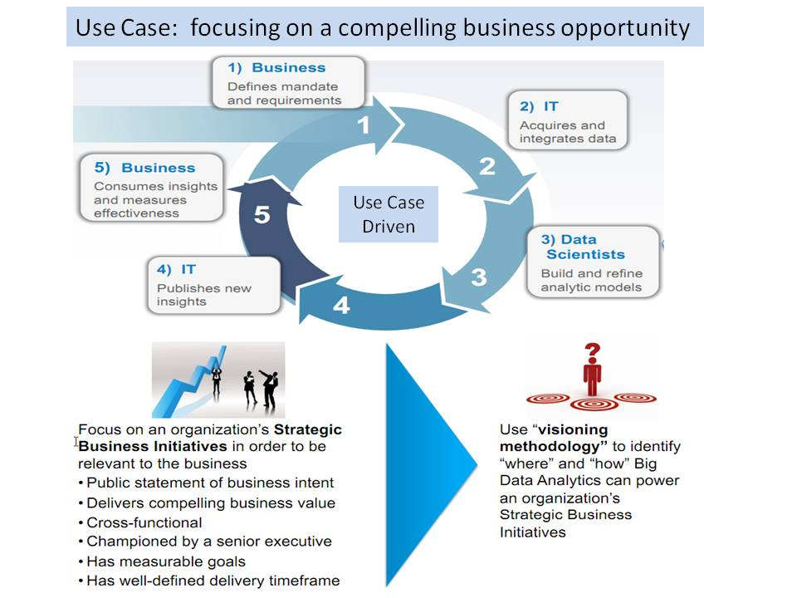
Business Data analytics (contd.)
Ref:https://www.google.co.in/search?q=Big+Data+Analytics&clien
RS-MSRIT

Slide 29
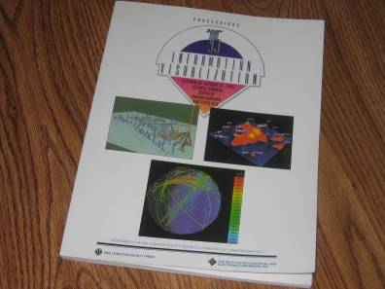
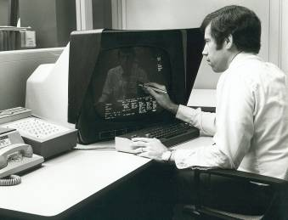
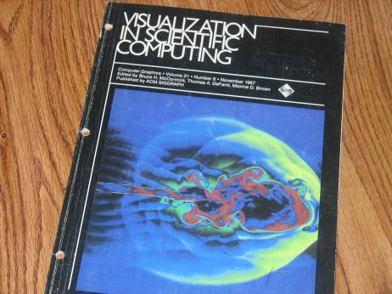
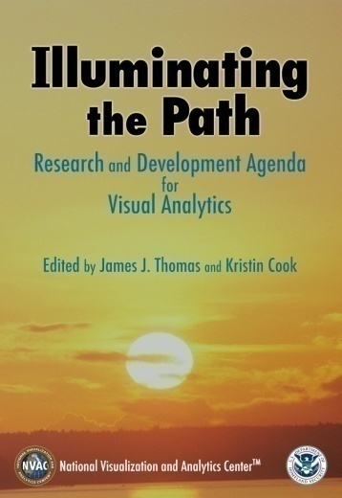
History of Graphics and Visualization
70s to 80s
  CAD/CAM Manufacturing, cars, planes, and chips
  3D, education, animation, medicine, etc.
90s to 2000s
  Information visualization
  Web and Virtual environments
80s to 90s
  Scientific visualization
  Realism, entertainment
2000s to 2010s
  Visual Analytics
  Visual/audio analytic appliances
RS-MSRIT

Slide 30
Visual Analytics Definition
Visual analytics is the science of analytical reasoning facilitated by interactive visual interfaces.
People use visual analytics tools and techniques to
    Synthesize information and derive insight from massive, dynamic, ambiguous, and often conflicting data
    Detect the expected and discover the unexpected
    Provide timely, defensible, and understandable assessments
    Communicate assessment effectively for action.
Jim Thomas
Founding Director, Science Advisor | National Visualization and Analytics Center
AAAS, PNNL Fellow
Pacific Northwest National Laboratory
Jim.Thomas@pnl.gov | http://nvac.pnl.gov
RS-MSRIT

Slide 31
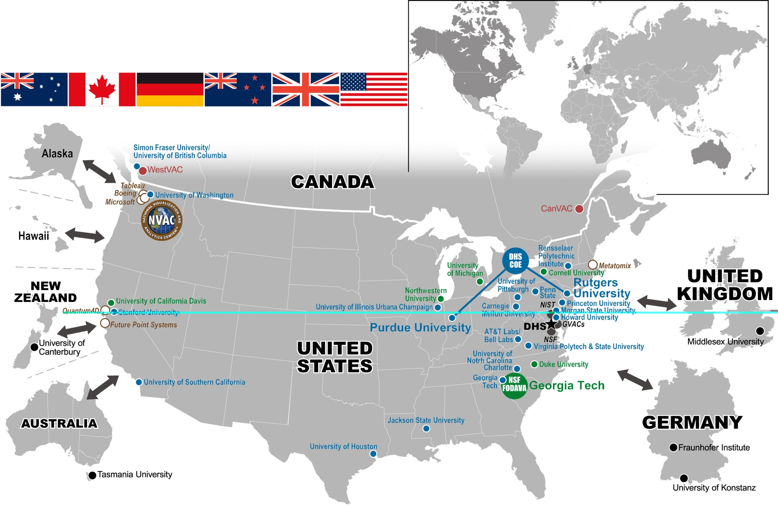
Visual Analytic Collaborations
Detecting the Expected --
Discovering the UnexpectedTM
Stanford
U of Calif Santa Cruz
Purdue
Michigan State
Carnegie Mellon
U of Maryland
Penn State
Princeton Univ
Virginia Tech
RS-MSRIT

Slide 32
Visual analytics
* Visual analytics is a form of inquiry in which data that provides insight into solving a problem is displayed in an interactive, graphical manner.
The approach uses data visualization technologies to help data scientists and other professionals identify trends, patterns and relationships in the data they are working with.
Packaged visual analytics software tools make it easier for non-technical users to use by including drag-and-drop options for setting and modifying analytical parameters.
Visual analytics applications must incorporate effective data management strategies in order to integrate, unify and standardize data coming from different source systems.
Visual analytics is especially helpful in applications involving large, complex data sets and analytical processes that require a high degree of monitoring and interaction
RS-MSRIT

Slide 33
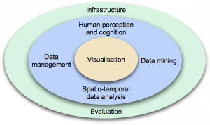
Visual analytics-Interdisciplinary
Ref: http://www.vismaster.eu/book/chapter-2-visual-analytics/
RS-MSRIT

Slide 34
Visual analytics-Interdisciplinary (contd.)
Visual analytics integrates science and technology from many disciplines.
Visualisation is at the heart of the system, the means to communicate data values or the results of some analysis
It is also increasingly being used to monitor processes in other disciplines, such as data management and data mining.
Infrastructure and evaluation are important to all the disciplines.
Infrastructure links together all the processes, functions and services required by visual analytic applications so they work in harmony.
Evaluation assesses the effectiveness, efficiency and user acceptance of the methods, models and theories in a standard way, so they can be compared and problems can be identified.
Ref: http://www.vismaster.eu/book/chapter-2-visual-analytics/
RS-MSRIT

Slide 35
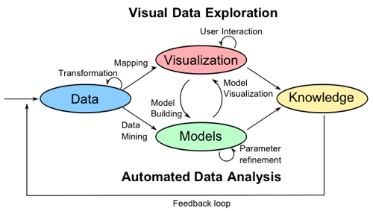
Visual Analytics Process
Ref: http://www.vismaster.eu/book/chapter-2-visual-analytics/
RS-MSRIT

Slide 36
Visual Analytics Process (contd.)
Combines automatic and visual analysis methods with a tight coupling through human interaction in order to gain knowledge from data.
Heterogeneous data sources need to be integrated before visual or automatic analysis methods can be applied (e.g. data cleaning, normalization, grouping, integration).
Analyst applies visual or automatic analysis methods.
Automated analysis uses data mining techniques to generate models of the original data that can be visualised for evaluation and refinement.
Alternating between visual and automatic methods is characteristic for the visual analytics process
Ref: http://www.vismaster.eu/book/chapter-2-visual-analytics/
RS-MSRIT

Slide 37
Visual Analytics Process (contd)
The visual analytics process is a combination of :
- automatic and visual analysis methods
- with a tight coupling through human interaction in order to gain knowledge from
data.
In Figure different stages (represented through ovals)
- their transitions (arrows) in the visual analytics process.
In many cases,, heterogeneous data sources need to be integrated
- before visual or automatic analysis methods can be applied.
First step : to preprocess and transform the data
- to extract meaningful units of data for further processing.
Typical preprocessing tasks are:
- data cleaning, normalization, grouping, or integration of heterogeneous data into a
common schema
Initial visualization is not sufficient for the analysis.
In contrast to traditional information visualization
- findings from the visualization reused to build a model for automatic analysis.
These models can also be built from the original data using data mining methods.
After model creation, the analyst can interact with the automatic methods
Model visualization can then be used to verify the findings of these models.
Alternating between visual and automatic methods is characteristic for the visual analytics
process - leads to a continuous refinement and verification of preliminary results.
https://www.uni-konstanz.de/mmsp/pubsys/publishedFiles/KeMaSt08.pdf
RS-MSRIT

Slide 38
Visual Analytics Science and Technology (VAST)
visualization as a scientific field encompass three major subfields:
- scientific visualization, information visualization, and visual analytics
Also includes many domain-specific areas:
- geo-information visualization
- biological data visualization
- software visualization
VAST Challenge:
- helps researchers understand how well the data transformations,
visualizations, and interactions in their visual analytics software can
be used to address a realistic analytic task.
RS-MSRIT

Slide 39
Example: Visual Analytics Characteristics
Whole-part relationship: multiple levels of information extraction
Relationship discovery: high dimensional analytics to detect the expected and discover the unexpected
Combined exploratory and confirmatory analytics
Selection, search (bool. and similarity) and groupings
Temporal and geospatial analytics
Extensive labeling: everything active on screen
Multiple linked views
Analytic interactions are foundational to critical thinking
Analytic reasoning framework
Capture analytic snippets for reporting
Both general and application specific applications
RS-MSRIT

Slide 40
Top Ten Challenges Within
Visual Analytics
Human Information Discourse for Discovery—new interaction paradigm based around cognitive aspects of critical thinking
New visual paradigms that deal with scale, multi-type, dynamic streaming temporal data flows
Data, Information and Knowledge Representation and synthesis
Synthesis and turning information into knowledge
Collaborative Predictive/Proactive Visual Analytics
Ref:
fodava.gatech.edu/files/uploaded/Review2009/FODAVAupdate.ppt
RS-MSRIT

Slide 41
Top Ten Challenges Within
Visual Analytics (contd.)
Visual Analytic Method Capture and Reuse
Dissemination and Communication
Visual Temporal Analytics
Delivering short-term products while keeping the long view
Interoperability interfaces and standards: multiple VAC suites of tools
Ref:
fodava.gatech.edu/files/uploaded/Review2009/FODAVAupdate.ppt
RS-MSRIT

Slide 42
Gartner’s Magic Quadrant
*Gartner’s Magic Quadrant -a gold standard in analyzing the technology
markets.
*They aim to place all vendors within 4 quadrants (challengers, leaders,
niche players and visionaries)
- with an emphasis on the ability to execute and completeness of vision.
*Recently, Gartner released their Magic Quadrant for Business
Intelligence and Analytics Platforms.
* In past Magic Quadrants, there was not an emphasis on the analytics
side of it
- but market demands have changed that.
Gartner defines the BI and Analytics platform market as “…a software
platform that delivers 15 capabilities across three categories:
integration, information, delivery and analysis.”
Systems within the newest Gartner Magic Quadrant are based on
strengths and weaknesses in the following categories:
RS-MSRIT

Slide 43
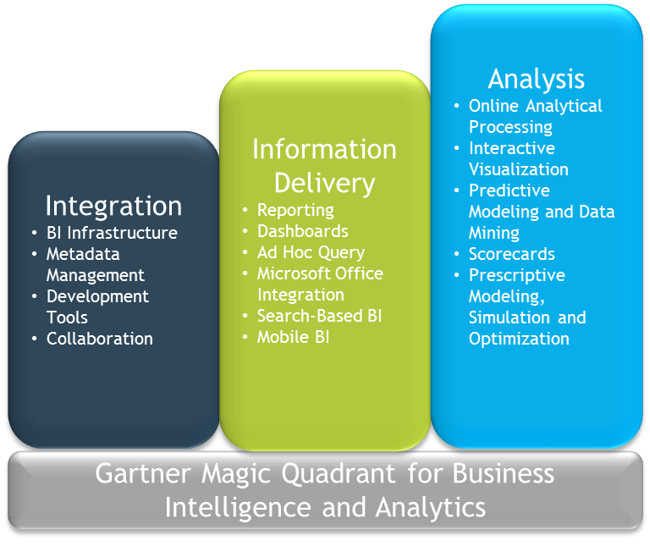
RS-MSRIT

Slide 44
Gartner’s Magic Quadrant (contd.)
Those in the business world are seeing more and more that organizations are aiming to
gain more insight from the data that they own.
Data is being used to improve ROI, efficiency, revenue…you name it!
Gartner states “Right now, most of the user activity in the BI and Analytics platform market is from organizations that are trying to mature from descriptive to diagnostic analytics.”
This means that there will be a critical shift in the markets towards prescriptive analytics (analytics aimed at finding the best course of action for a given situation).
We’ve already seen the market make a move in this direction with Tableau’s updates and the launch of IBM Cognos Insight in 2012.
file:///I:/For%20Analytics%20Course/Gartner.html
RS-MSRIT

Slide 45
Gartner’s Magic Quadrant (contd.)
* Five Use Cases
Vendors are assessed for their support of five main use cases:
1. Agile Centralized BI Provisioning. Supports an agile IT-enabled workflow — from data to centrally delivered and managed content — using the self-contained data management capabilities of the platform.
2. Decentralized Analytics. Supports a workflow from data to self-service analytics.
3. Governed Data Discovery. Supports a workflow from data to self-service analytics, to systems-of-record, IT-managed content with governance, reusability and promotability.
4. Embedded BI. Supports a workflow from data to embedded BI content in a process or application.
5. Extranet Deployment. Supports a workflow similar to agile centralized BI provisioning for the external customer or, in the public sector, citizen access to analytic content.
file:///I:/For%20Analytics%20Course/Gartner.html
RS-MSRIT

Slide 46
Gartner’s Magic Quadrant (contd.)
*14 Critical Capabilities of a BI and Analytics Platform
*Vendors are also assessed according to the following 14 critical capabilities
Infrastructure
1. BI Platform Administration. Capabilities that enable scaling the platform, optimizing performance and ensuring high availability and disaster recovery.
2. Cloud BI. Platform-as-a-service and analytic-application-as-a-service capabilities for building, deploying and managing analytics and analytic applications in the cloud, based on data both in the cloud and on-premises.
3. Security and User Administration. Capabilities that enable platform security, administering users, and auditing platform access and utilization.
4. Data Source Connectivity. Capabilities that allow users to connect to the structured and unstructured data contained within various types of storage platforms, both on-premises and in the cloud.
file:///I:/For%20Analytics%20Course/Gartner.html
RS-MSRIT

Slide 47
Gartner’s Magic Quadrant (contd.)
Data Management
5. Governance and Metadata Management. Tools for enabling users to share the same systems-of-record semantic model and metadata. These should provide a robust and centralized way for administrators to search, capture, store, reuse and publish metadata objects, such as dimensions, hierarchies, measures, performance metrics/key performance indicators (KPIs) and report layout objects, parameters and so on. Administrators should have the ability to promote a business-user-defined data model to a system-of-record metadata object.
6. Self-Contained Extraction, Transformation and Loading (ETL) and Data Storage. Platform capabilities for accessing, integrating, transforming and loading data into a self-contained storage layer, with the ability to index data and manage data loads and refresh scheduling.
7. Self-Service Data Preparation. The drag-and-drop, user-driven data combination of different sources, and the creation of analytic models such as user-defined measures, sets, groups and hierarchies. Advanced capabilities include semantic autodiscovery, intelligent joins, intelligent profiling, hierarchy generation, data lineage and data blending on varied data sources, including multistructured data.
RS-MSRIT
file:///I:/For%20Analytics%20Course/Gartner.html

Slide 48
Gartner’s Magic Quadrant (contd.)
Analysis and Content Creation
8. Embedded Advanced Analytics. Enables users to easily access advanced analytics capabilities that are self-contained within the platform itself or available through the import and integration of externally developed models.
9. Analytic Dashboards. The ability to create highly interactive dashboards and content, with visual exploration and embedded advanced and geospatial analytics, to be consumed by others.
10. Interactive Visual Exploration. Enables the exploration of data via the manipulation of chart images, with the color, brightness, size, shape and motion of visual objects representing aspects of the dataset being analyzed. This includes an array of visualization options that go beyond those of pie, bar and line charts, to include heat and tree maps, geographic maps, scatter plots and other special-purpose visuals. These tools enable users to analyze the data by interacting directly with a visual representation of it.
11. Mobile Exploration and Authoring. Enables organizations to develop and deliver content to mobile devices in a publishing and/or interactive mode, and takes advantage of mobile devices' native capabilities, such as touchscreen, camera, location awareness and natural-language query.
file:///I:/For%20Analytics%20Course/Gartner.html
RS-MSRIT

Slide 49
Gartner’s Magic Quadrant (contd.)
Sharing of Findings
12. Embedding Analytic Content. Capabilities including a software developer's kit with APIs and support for open standards for creating and modifying analytic content, visualizations and applications, embedding them into a business process, and/or an application or portal. These capabilities can reside outside the application (reusing the analytic infrastructure), but must be easily and seamlessly accessible from inside the application without forcing users to switch between systems. The capabilities for integrating BI and analytics with the application architecture will enable users to choose where in the business process the analytics should be embedded.
13. Publishing Analytic Content. Capabilities that allow users to publish, deploy and operationalize analytic content through various output types and distribution methods, with support for content search, storytelling, scheduling and alerts.
14. Collaboration and Social BI. Enables users to share and discuss information, analysis, analytic
file:///I:/For%20Analytics%20Course/Gartner.html
RS-MSRIT

Slide 50
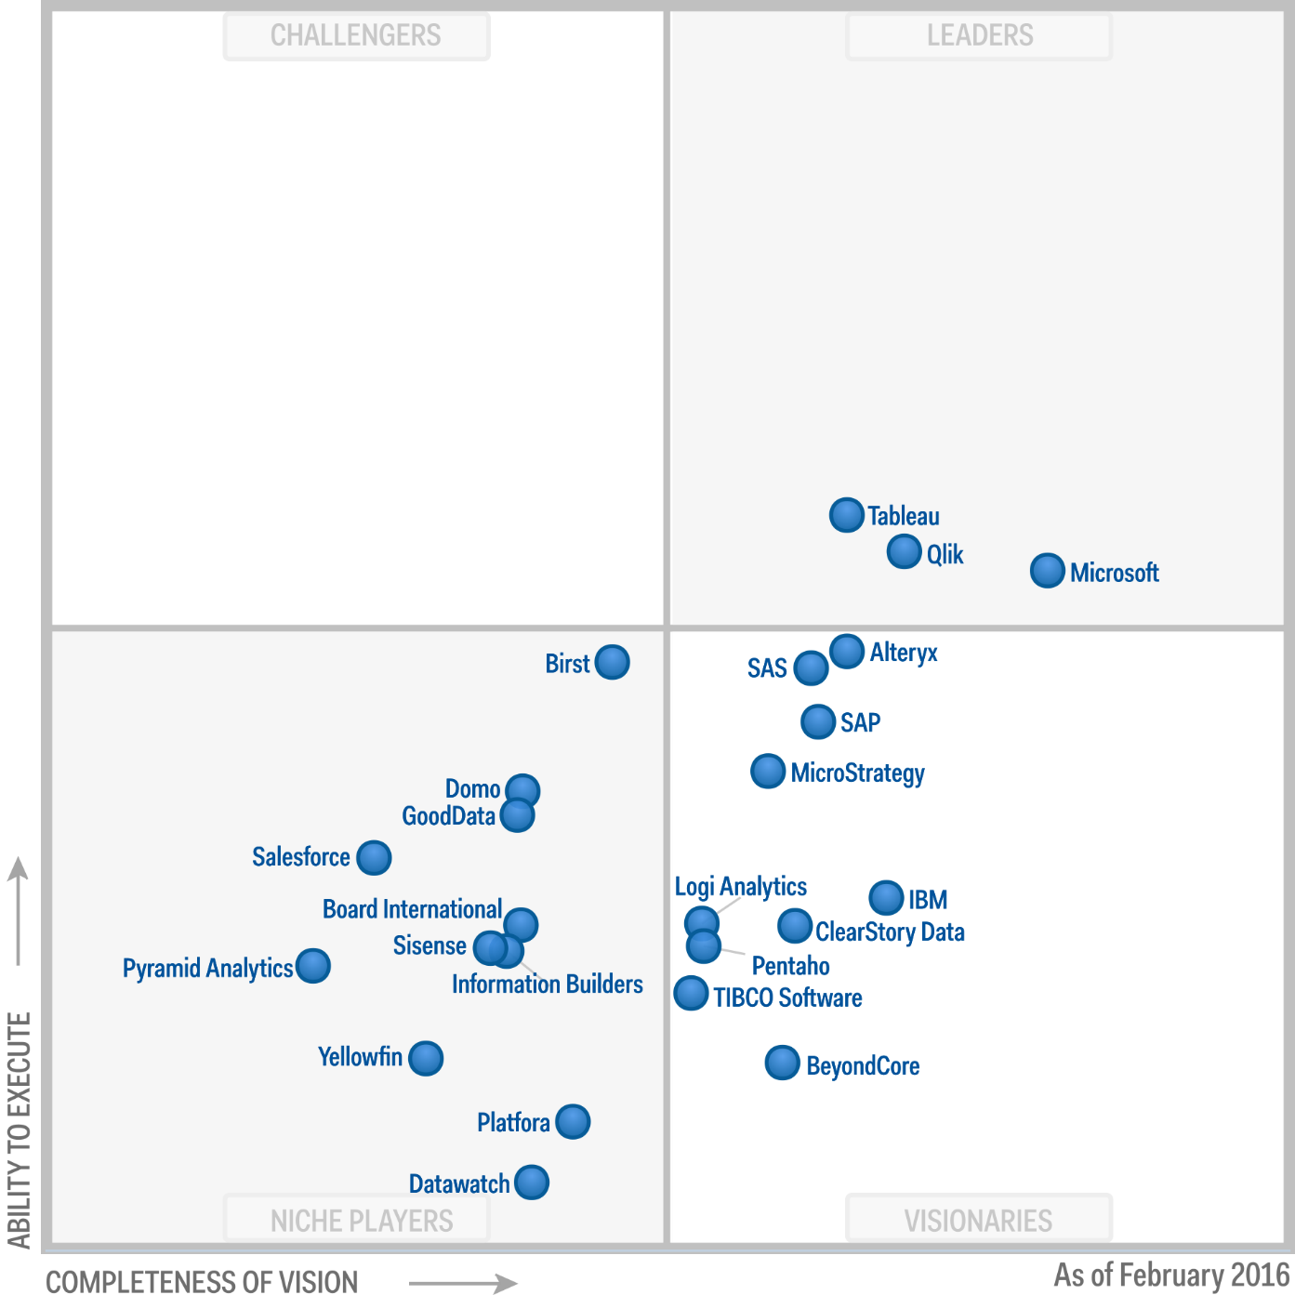
Gartner’s Magic Quadrant (contd.)
Magic Quadrant for Business Intelligence and Analytics Platforms
RS-MSRIT

Slide 51
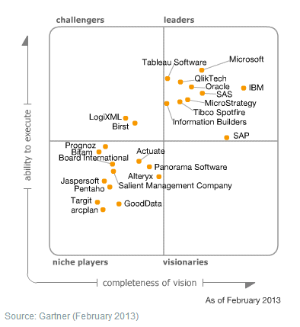
Gartner’s Magic Quadrant (contd.)
* Gartner’s Magic Quadrant (pictured) is formed from the axes of vision and execution.
Tableau falls between the niche players and visionaries on the X-axis and a high level of execution on the Y-axis.
*From this we can assume that Tableau is seen by many as having very high usability and a middle-of-the-road completeness of suite.
RS-MSRIT

Slide 52
Gartner’s Magic Quadrant (contd.)
Gartner forecasts:
* By 2018, most business users and analysts in organizations will have access to self-service tools to prepare data for analysis as part of the shift to deploying modern BI platforms.
*By 2018, most stand-alone self-service data preparation offerings will either have expanded into end-to-end analytical platforms or been integrated as features of existing analytics platforms.
*By 2018, smart, governed, Hadoop-based, search-based and visual-based data discovery will converge in a single form of next-generation data discovery that will include self-service data preparation and natural-language generation.
RS-MSRIT

